Slide 1

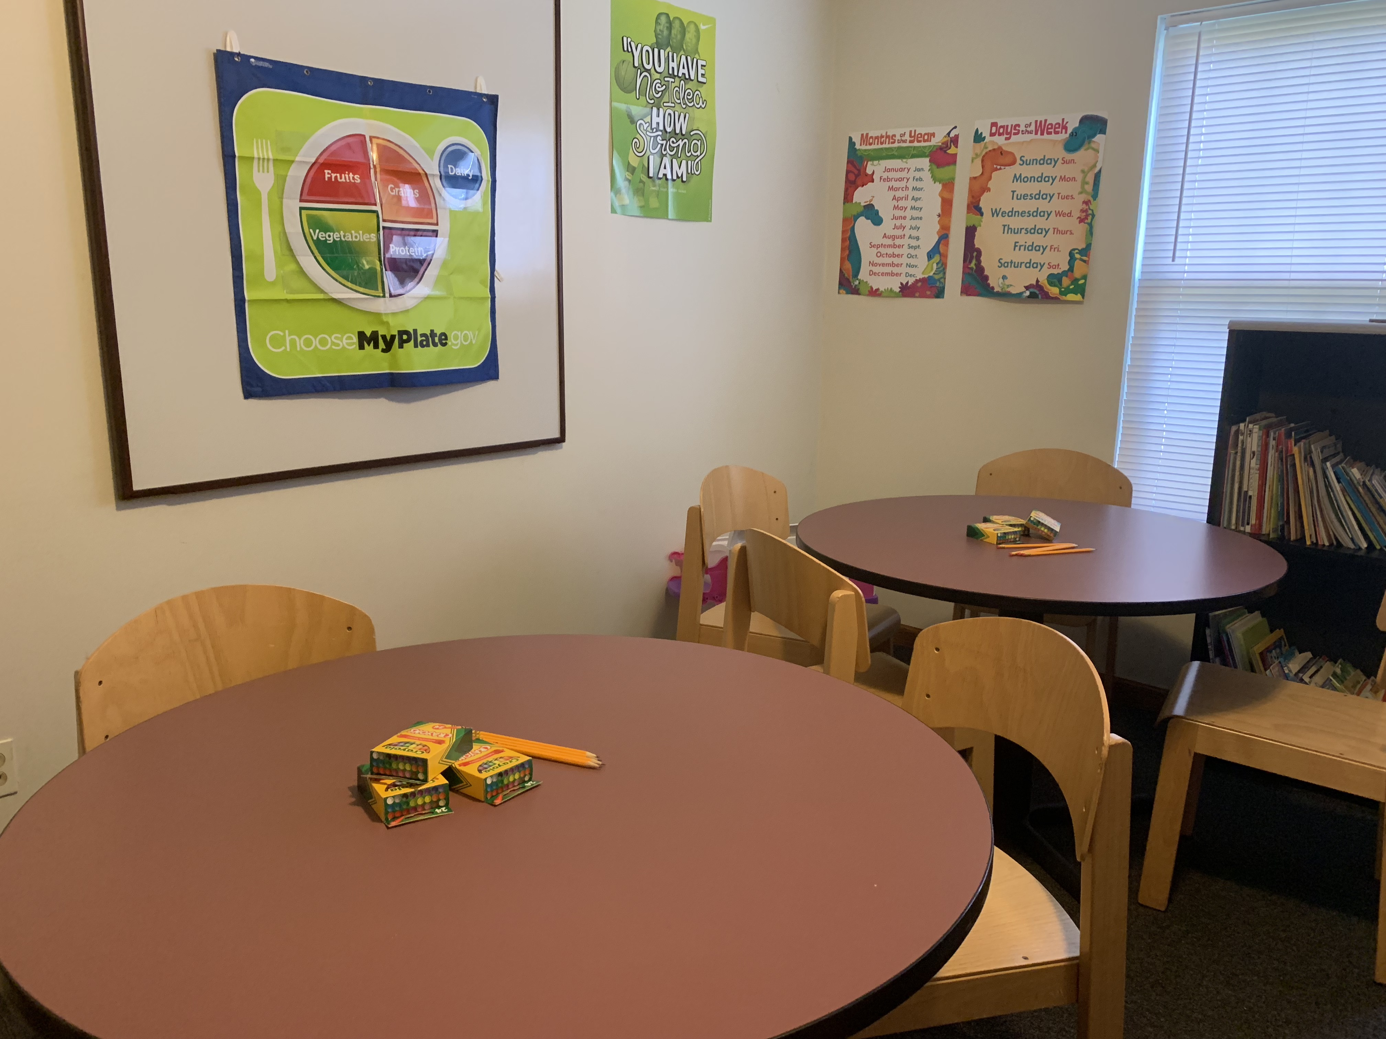
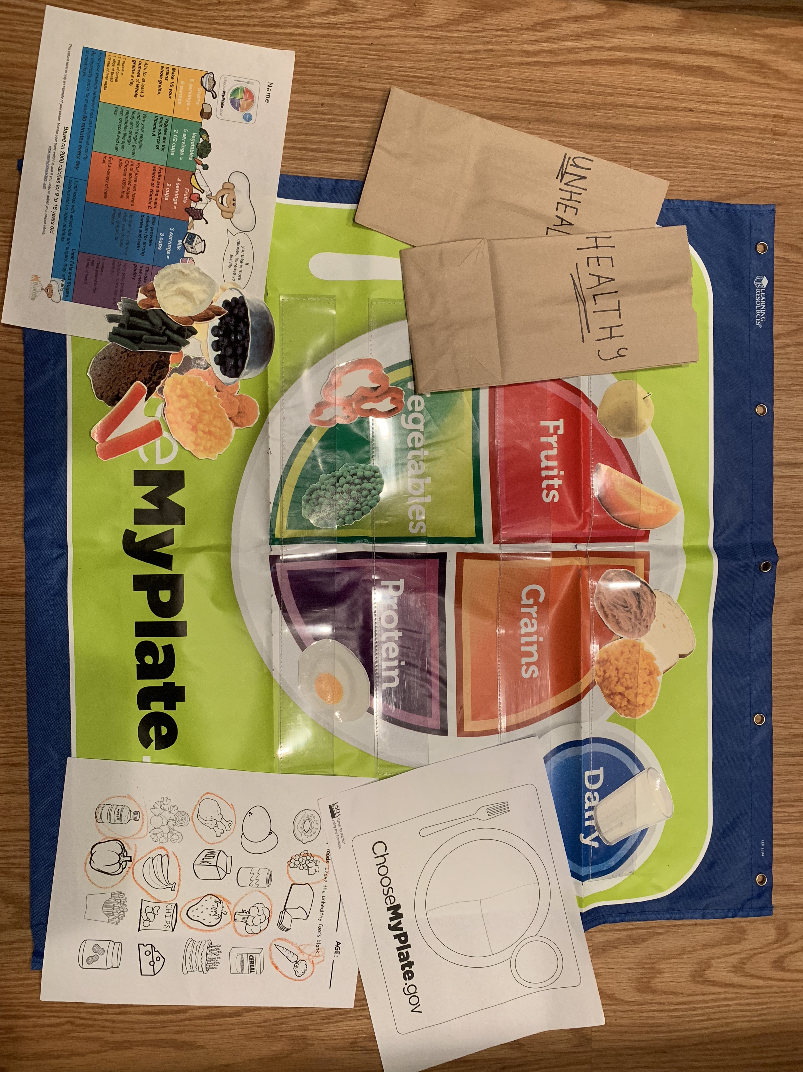
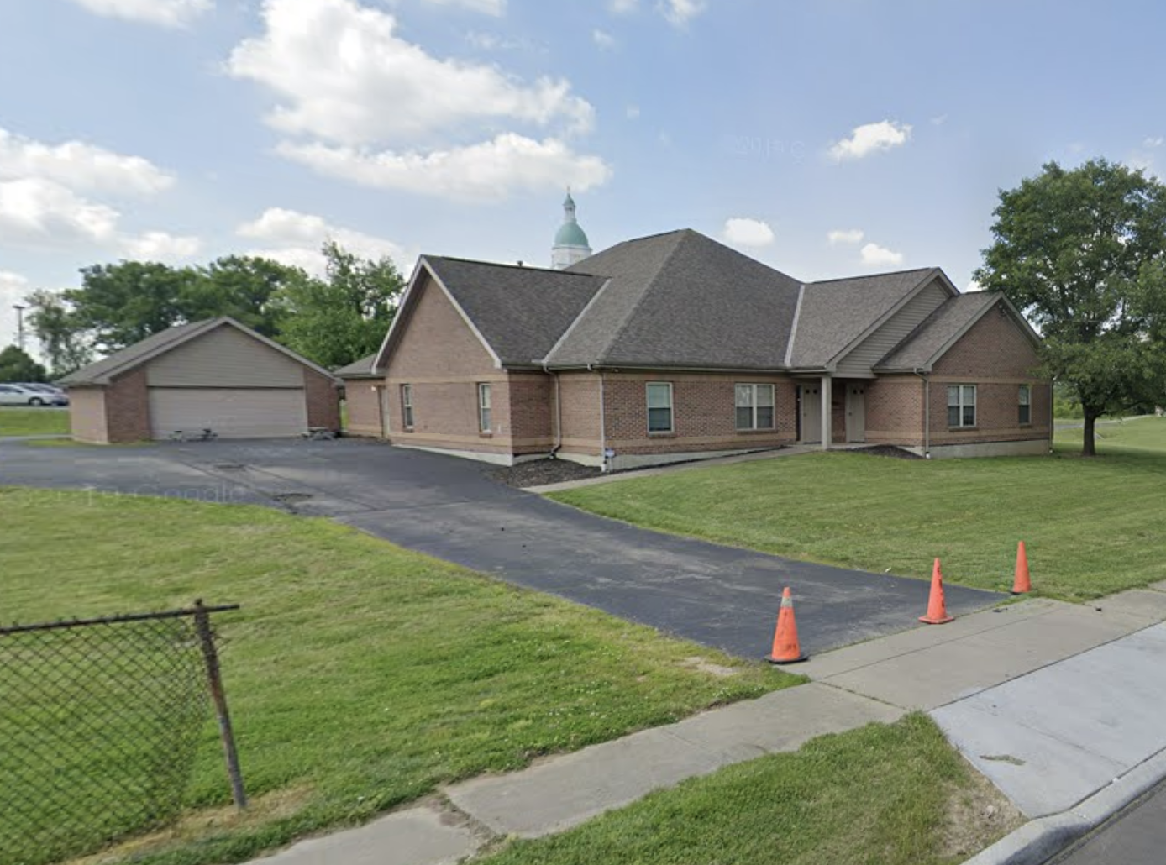
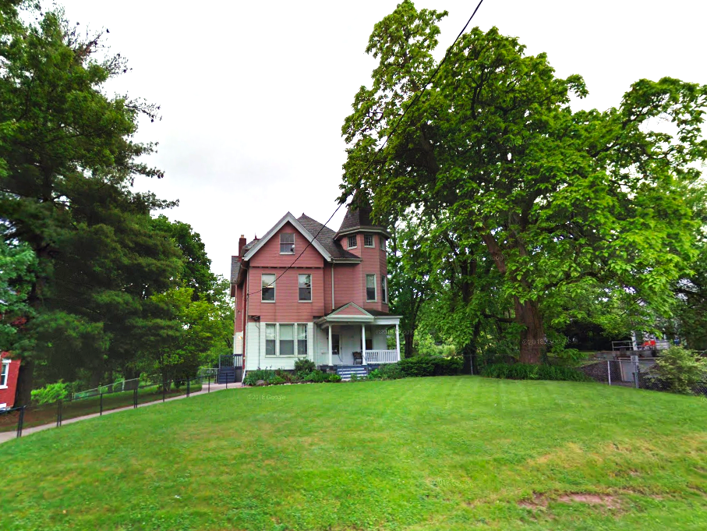
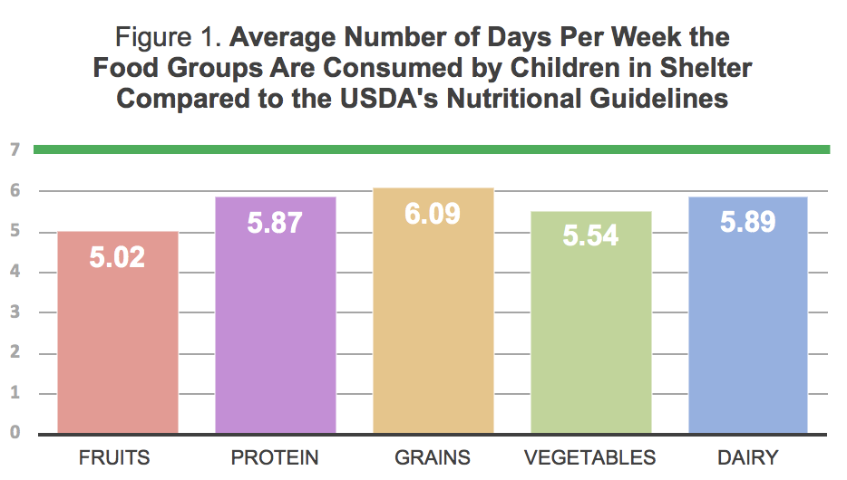
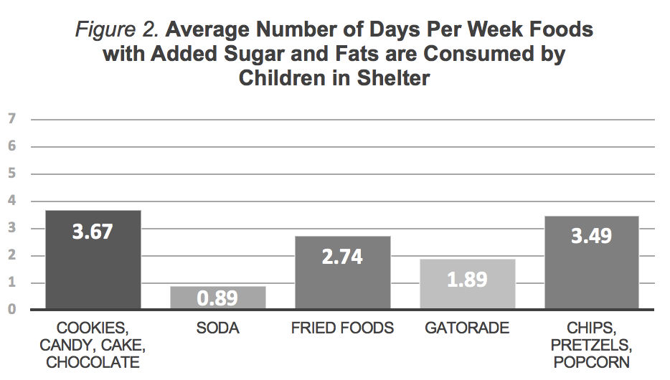
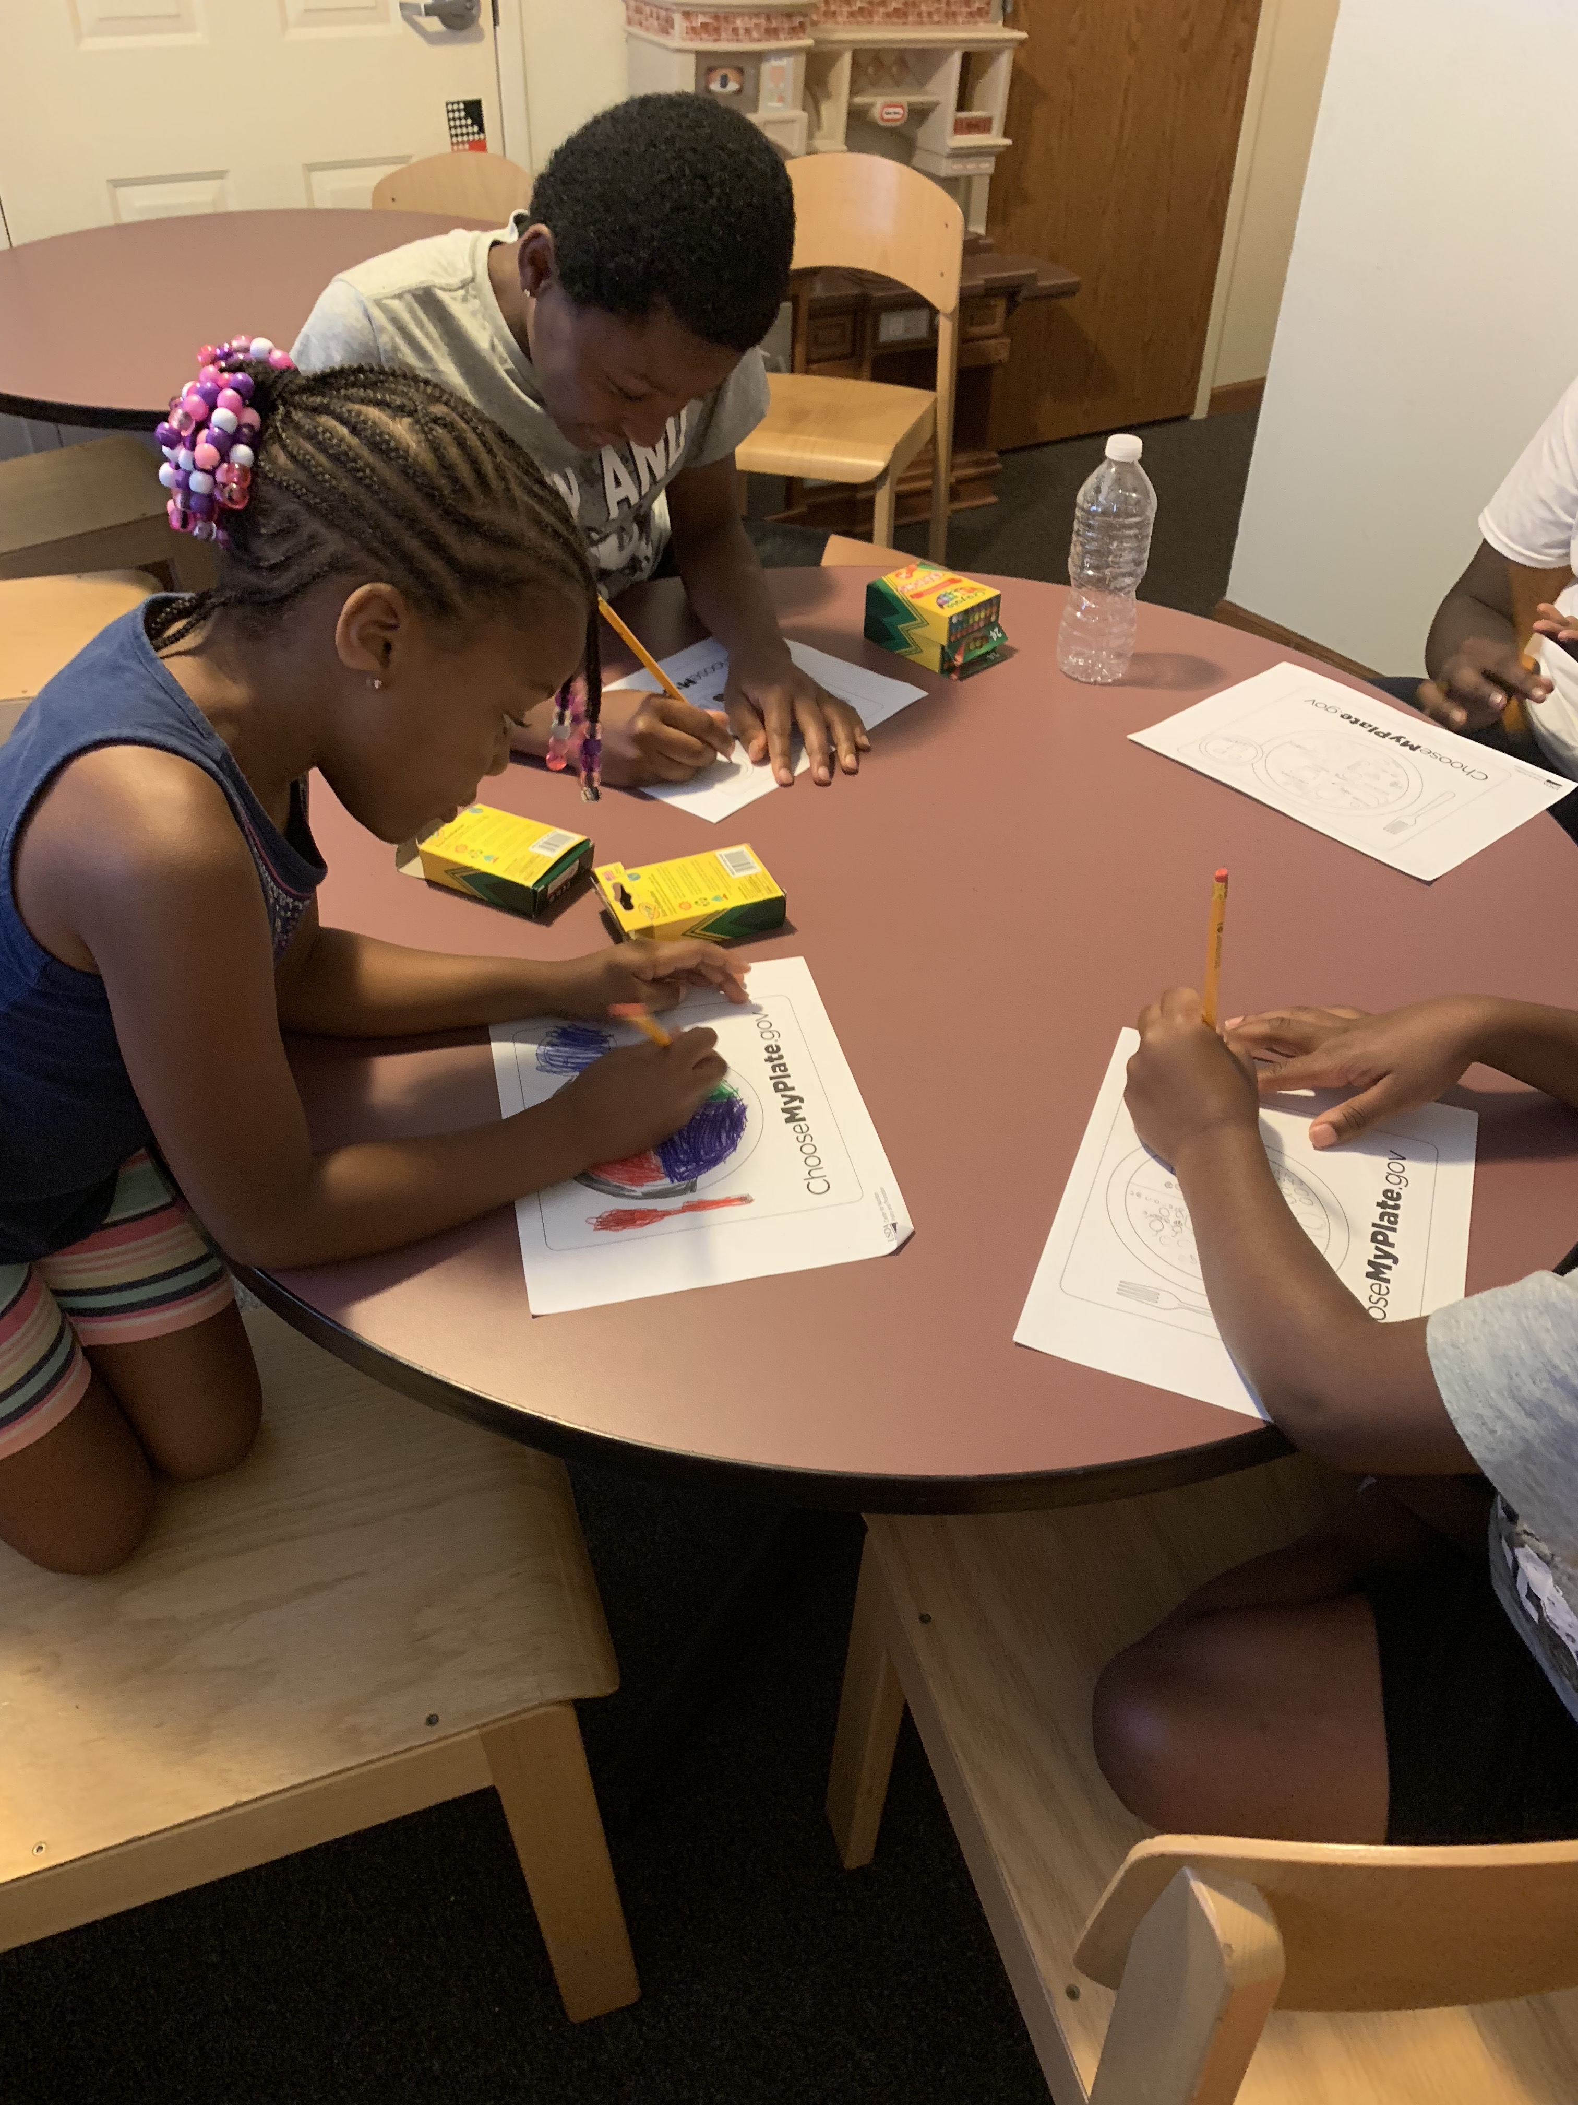
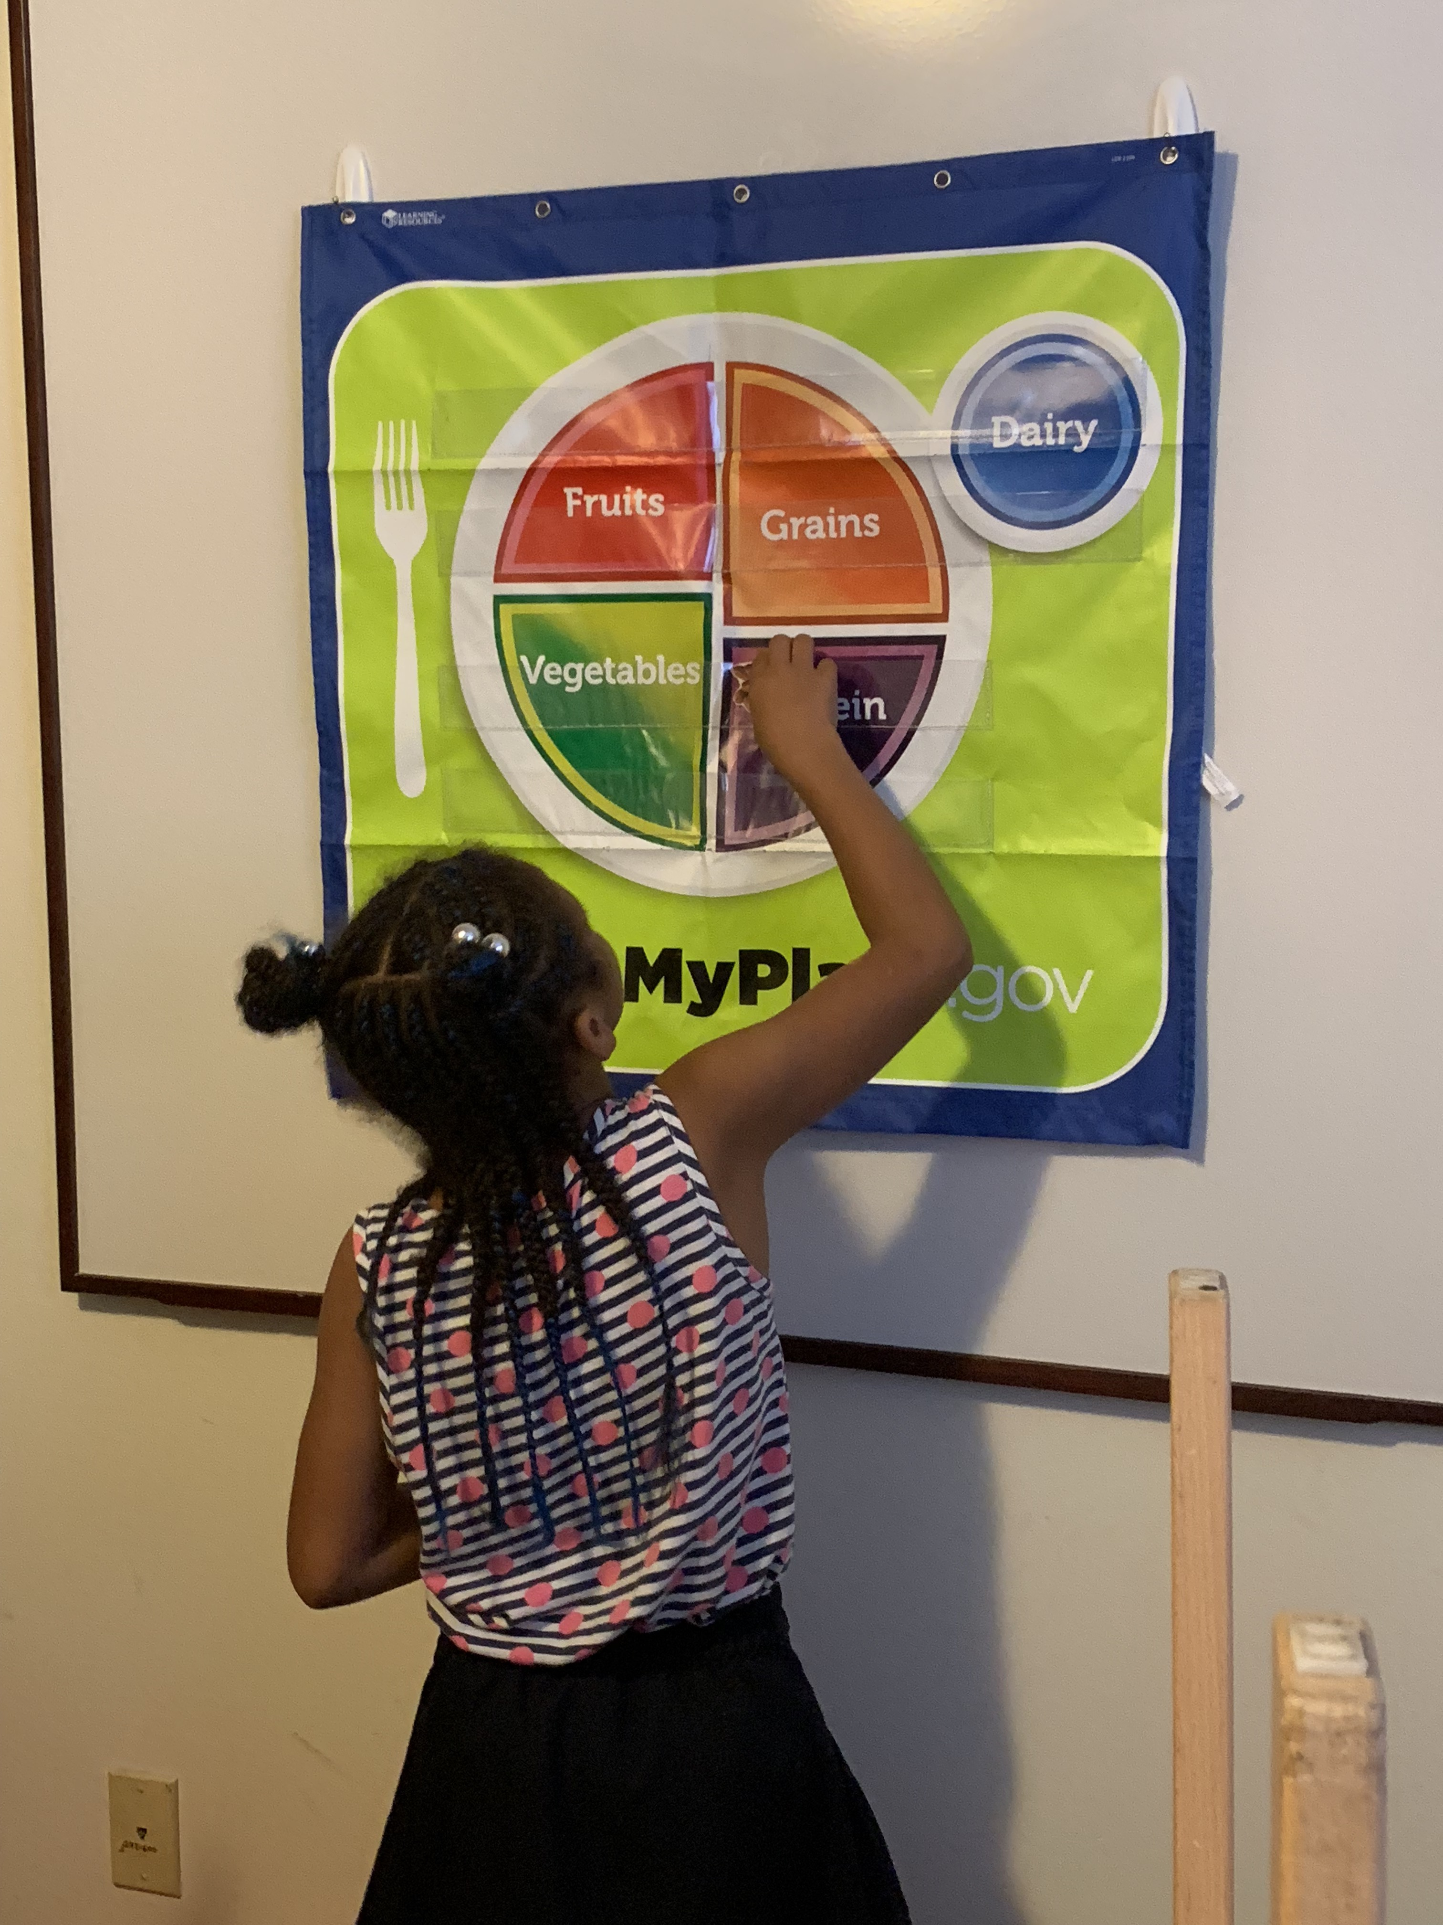
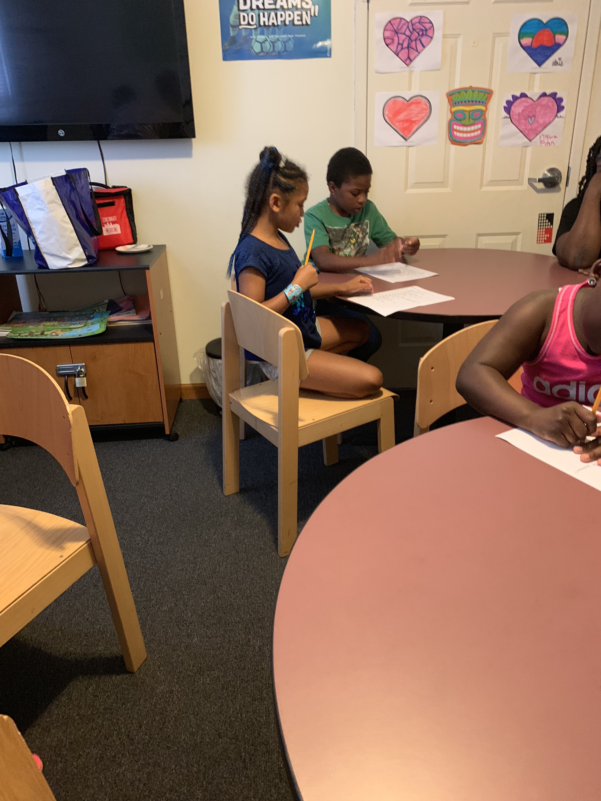
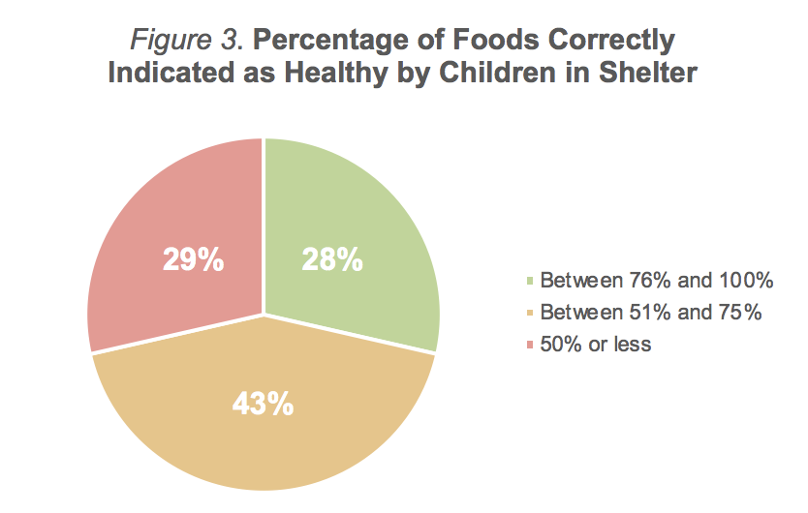
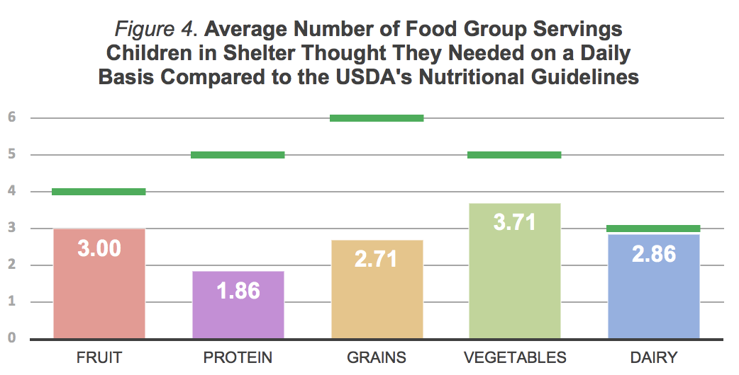
MyPlate to Their Plate: A Nutrition Course for Cincinnati’s Homeless Children and Adolescents
Gina Livecchi^{1, 2}
¹ Urban Health Project, ² University of Cincinnati College of Medicine
About Bethany House Services
Mission: Bethany House Services empowers homeless and at-risk families with the solutions to achieve housing stability and long-term self-sufficiency.
Vision: To live in a community where all families have a place to call home and no one spends a night without shelter.
Founded in 1983, Bethany House Services (BHS) is the largest family homeless shelter and one of the largest Rapid Re-Housing Programs in Cincinnati.¹ BHS can house up to 130 people across its five sites, and in 2018 alone they were able to provide shelter to 302 families.² Along with being provided a temporary residence, the clients at BHS work with a case manager during their stay in order to obtain employment, permanent housing, childcare, and other resources necessary to ensure a stable future after leaving the shelter. Clients staying at Bethany House also have access to child/parent programming, mental health services, educational classes, and much more.
My Project: The Nutrition Course
Future Directions
I plan to provide Bethany House Services with all of the resources that I’ve compiled and the curriculum I designed so the classes can continue to be taught by either staff members or future interns at the site. Since the shelter aims to have all families in and out of the shelter in 30 days or less, the course could be taught fairly regularly to hopefully reach a large number of children. Furthermore, I hope that my project will inspire others to design and implement courses in other areas, such as budgeting, tips for stress reduction, preparing for job interviews, or résumé building, so that both the adults and children at the shelter leave feeling more prepared to take on future challenges.
Why Nutrition?
According to a study published in 1990, homeless and underprivileged youths do not consume adequate amounts of core food groups, especially vegetables and meat, while they do consume an excess of fast food.³ Eighteen years later, another study found that homeless children still were not eating sufficient fruits, vegetables, and dairy.⁴ Statistics like these have led to a number of nutritional programs for the homeless being introduced across the country, which inspired my summer project for BHS.
Preparation for the Course
Parent Survey
I surveyed parents at the shelter to get an idea about what their children typically ate and how that lined up with national guidelines. I found that, on average, children in shelter were not consuming foods from all five food groups on a daily basis (Figure 1). I also discovered that while only five out of fifteen parents surveyed said their kids were eating foods from every group every day, 67% of the group still thought their children were meeting national guidelines. On average, these children were also consuming foods with added sugars and fats multiple days during the week (Figure 2).
Child Survey
Before starting the course, I asked the children staying at the shelter to fill out several worksheets regarding food groups and healthy eating. None of the children surveyed were able to identify all five food groups, and, on average, all seven of the children underestimated the servings of each food group they should eat in a day (Figure 4). When asked to distinguish healthy foods from unhealthy foods, only two out of the seven correctly identified 75% or more of the healthy foods (Figure 3).
Course Design
The Curriculum
The curriculum for the course is based on dietary and nutrition information from the United States Department of Agriculture’s MyPlate program. Resources used for the course are from the USDA’s online “Serving Up MyPlate” curriculum, the Florida Department of Health “A Dozen Ways to Be Healthy” curriculum, and self-produced worksheets and activities.
Lesson Plans
The course is divided up into four classes and Classes 1-3 have a specific topic relating to nutrition and healthy eating. These classes have a lecture component where the children are taught material related to the topic. Lectures are also paired with an in-class activity to reinforce this knowledge. The class ends with a game related to the material learned to allow the children to get up and move while still thinking about what they learned today. Class 4 is a hands-on cooking class where the children will get to use their knowledge about healthy foods to create healthy snacks. Topics for the classes are as follows:
Class 1: Food Groups and MyPlate Introduction
Class 2: Servings of Food Groups
Class 3: Identifying and Limiting Unhealthy Foods
Class 4: Cooking Healthy Snacks
Acknowledgments
I would like to thank the staff at Bethany House, especially Ms. Gwen Green, Ms. Janice Clay, and Ms. Denise Hill, for all of their support and guidance over the summer. I would also like to thank all of the families across the Fairmount, Bond Hill, and McHenry shelter locations for working with me and allowing my project to be a success. Finally, I would like to thank Isaiah Noel and Namratha Kolur, co-director of of Urban Health Project, for all of their help these past few months.
References
¹ Bethany House Services. (2019). Community Impact. Retrieved from https://bethanyhouseservices.org/community-impact/
² Bethany House Services. (2019). A Record Year. Bethany House Services Front Porch News, Winter 2019, 3.
³ Wood, D.L., Burciaga Valdez, R., Hayashi, T., & Shen, A. (1990). Health of homeless children and housed, poor families. Pediatrics, 86(6), 858-66.
⁴ Smith, C. & Richards, R. (2008). Dietary intake, overweight status, and perceptions of food insecurity among homeless Minnesotan youth. American Journal of Human Biology, 20(5), 550-63.
Intern Roles and Responsibilities
During my summer at Bethany House, I split my time between working with the Child/Parent Coordinator and assisting the case managers. My typical roles and responsibilities included:
Observing intake procedures
Attending case manager meetings with clients
Compiling and editing case notes
Following up with previous clients via phone about aftercare services after exiting shelter
Providing childcare for families participating in activities or having meetings with their case managers
Attending Kid’s Zone at the Bond Hill location
Designing and implementing a nutrition curriculum for the children staying at shelter
Attending civic meetings with the Shelter Director and Assistant Shelter Director, such as the Greater Cincinnati Homeless Coalition’s monthly meeting

